Slide 1

Agile Methodologies
Submitted By : Rashmi Rawat

Slide 2

INSTRUCTIONS: To change fonts from EY Interstate to Arial and vice versa
> On the “Home” tab, in the group of buttons labelled “Editing,” click the drop-down arrow in the button labelled “Replace” and choose “Replace Fonts.”
> Chose the font that you would like to replace and specify which font you’d like to appear in its place.
> Click Replace.
> It may take some time for the process to complete, depending on how much text you have in your presentation.
Content
1
Agile and It’s Benefits
2
Agile Values
3
Principles of Agile
Page 03
Page 08
Page 10
4
Agile Planning
5
Scrum
6
Different Methodologies in Agile
Page 12
Page 15
Page 19
7
Advantages and Disadvantages of Agile
Page 21

Slide 3

1
Sample Image – Can be changed
Agile and It’s Benefits

Slide 4
Agile and it’s Benefits
What is Agile?
Agile software development refers to a group of software development methodologies based on iterative development, where requirements and solutions evolve through collaboration between self-organizing cross-functional teams. )
Agile methods or Agile processes generally promote a disciplined project management process that encourages frequent inspection and adaptation, a leadership philosophy that encourages teamwork, self-organization and accountability, a set of engineering best practices intended to allow for rapid delivery of high-quality software, and a business approach that aligns development with customer needs and company goals.
Agile development refers to any development process that is aligned with the concepts of the Agile Manifesto.
The Manifesto was developed by a group of fourteen leading figures in the software industry, and reflects their experience of what approaches do and do not work for software development.
Agile is a process by which a team can manage a project by breaking it up into several stages with idea of iterative and incremental development where requirements and solutions evolve through collaboration between self-organizing cross-functional teams.
It involves constant collaboration with stakeholders and continuous improvement and iteration at every stage.
Agile is a group of methodologies that demonstrate a commitment to tight feedback cycles and continuous improvement.
As the product team delivers demonstrable functions at the end of every iteration, the process of securing customer feedback is simplified as features can be shown to customers then, instead of having to wait until the final released product.

Slide 5
Benefits of Agile Methodology (contd.)
The benefits of Agile project management will vary from case to case, as different teams implement best practices their own way. However, it is generally understood that Agile offers the following core benefits:
By involving customers in the development process, Agile teams keep them in the loop and show that they value their opinion. Stakeholders want to be engaged throughout the project life cycle so they can offer feedback and ensure that the final product will be suited to their needs. These tailor-made deliverables will likely improve the overall user experience and boost customer retention.
Satisfied
Customers
Agile methodologies use an iterative approach to project management, meaning processes are improved upon each time an interval is repeated. This consistent focus on improvement and quality control is one of the core principles of Agile, and it helps to create superior products.
Improved
quality
The central theme of Agile is flexibility. Agile teams are responsive to change, even at the last minute, and can adapt to it without much disruption. Project deliverables are not set in stone, so teams can easily reassess their plans and adjust their priorities to align with updated goals. Being adaptable means teams can deliver consistently and manage clients’ changing requirements effectively.
Adaptability
Agile teams work in short time periods, sometimes referred to as sprints. These fixed durations (e.g., two weeks) make it easier for project managers to measure team performance and assign resources accordingly. It is also easier to predict costs for shorter time periods than for a long-term project, simplifying the estimation process.
Predictability

Slide 6
Benefits of Agile Methodology (contd.)
Developers regularly assess progress during sprints, meaning they have better visibility into the project and can spot potential obstacles quickly. These minor issues can be tackled before they escalate, creating an effective risk mitigation process and giving the project a greater chance of success.
Reduced risk
Agile teams prioritize face-to-face communication and continuous interaction. They will usually conduct daily meetings to ensure everyone is on the same page and working towards the same objectives. By regularly communicating with each other, they eliminate potential confusion to successfully achieve their objectives.
Better communication

Slide 7
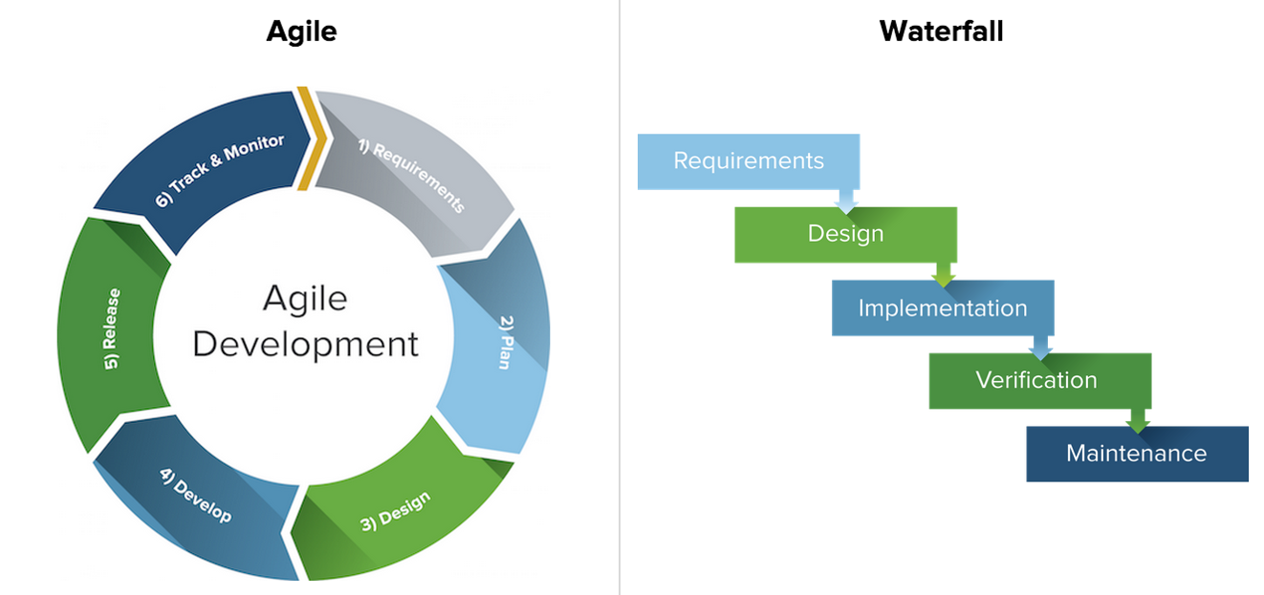
Agile Vs Waterfall
Continuous Cycles
Informal, decisions are made by the team
Embraces changes
Testing is done at end of each sprint
Flexible, continuous evolution
Sequential/Liner stages
Formal, hierarchical, Project Manager in charge
No changes throughout the project
Testing is done at end of the project
Best for simple/unchanging projects

Slide 8
2
Sample Image – Can be changed
Agile Values

Slide 9
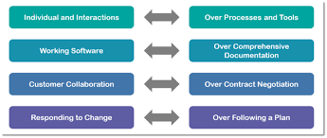
Agile Manifesto
The agile manifesto is a document that sets out the key values and principles behind the agile philosophy and serves to help development teams work more efficiently and sustainably. it is designed to improve software development methodologies, and directly responds to the inefficiency of traditional development processes.

Slide 10
3
Sample Image – Can be changed
Principles of Agile

Slide 11
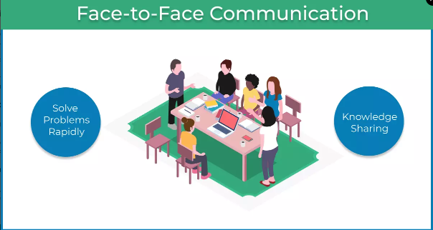
Principles of Agile
II Agile 12 Principles
Satisfy Customers Through Early & Continuous Deliver
Delivering the Value faster
Welcome Changing Requirements Even Late in the Project
Responding to the change
Deliver Value Frequently
Break the Silos of Your Project
Agile relies on cross-functional teams to make communication easier between the different stakeholders in the project
Build Projects Around Motivated Individuals
Trying to build a collaboration - reducing micromanagement and empowering motivated team members, projects will be completed faster and with better quality
The Most Effective Way of Communication is Face-to-face
The most efficient and effective method of conveying information to and within a development team is face-to-face conversation

Slide 12
4
Sample Image – Can be changed
Agile Planning

Slide 13
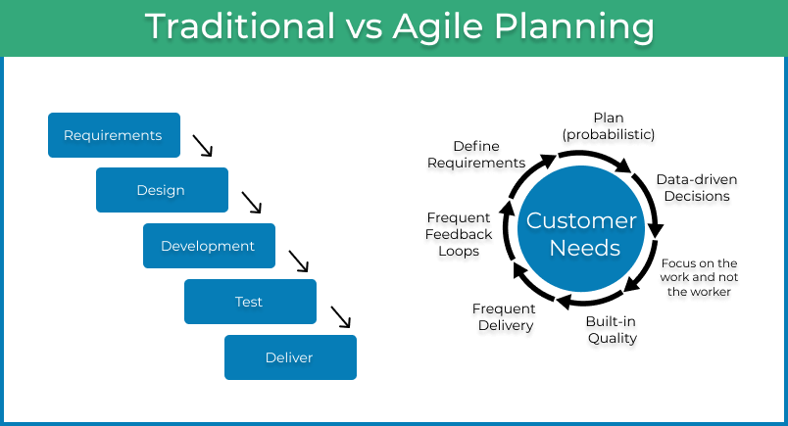
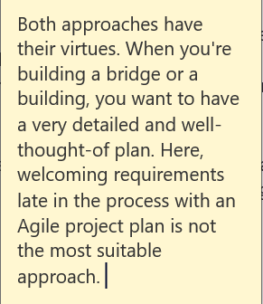
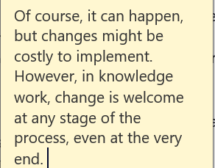
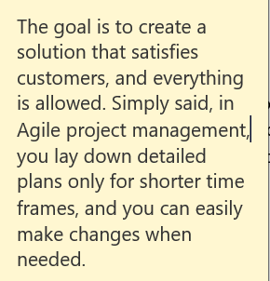
Principles of Agile
III Agile Planning
Agile Project Planning VS Traditional Project Planning
In the past, business leaders spent enormous amounts of time laying out detailed plans of execution for years in the future. For a long time, this way of planning worked perfectly. However, as markets became more dynamic in the last decades of the 20th century, business requirements began to change more frequently, and a new, more flexible way of planning was necessary.
The main difference between Agile planning and the traditional way (also known as Waterfall) is that the first one is iterative and adaptive to changes. In contrast, the second one is a step-by-step heavy planning process.

Slide 14
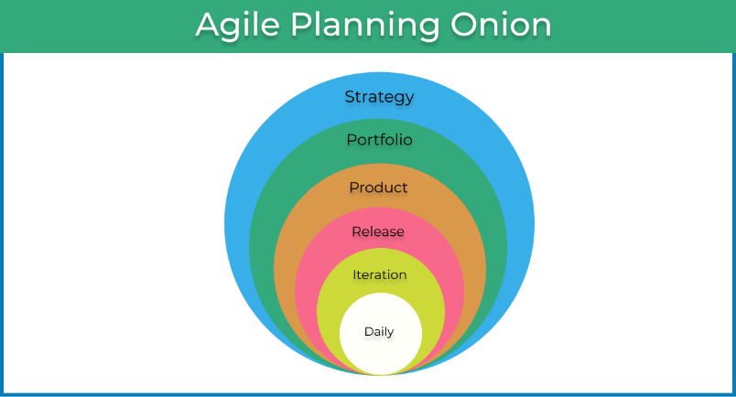
Characteristics of Agile Project Planning
The Goal from the eyes of a customer (Value)
An Agile plan must consider what exactly the customer wants. If we need to borrow a term from the Lean dictionary, we will use the word Value. In other words, our plan must be clear on how and when we are going to deliver value to the customer.
The Goal from the eyes of a customer (Value)
An Agile plan must consider what exactly the customer wants. If we need to borrow a term from the Lean dictionary, we will use the word Value. In other words, our plan must be clear on how and when we are going to deliver value to the customer.
Focus on the work and not the worker
It is most certainly true that you have specialists on the team, which creates many dependencies, especially in larger companies. An Agile coach's natural response would be to eliminate the dependencies, but this is an answer detached from the real world. You can't just remove all dependencies without creating a ton of problems elsewhere in the organization.

Slide 15
5
Sample Image – Can be changed
Scrum

Slide 16
Scrum
What is Scrum
Scrum is an agile development methodology used in the development of Software based on an iterative and incremental processes.
Scrum is adaptable, fast, flexible and effective agile framework that is designed to deliver value to the customer throughout the development of the project.
The primary objective of Scrum is to satisfy the customer’s need through an environment of transparency in communication, collective responsibility and continuous progress.
The development starts from a general idea of ​​what needs to be built, elaborating a list of characteristics ordered by priority (product backlog) that the owner of the product wants to obtain.
History of Scrum
The history of Scrum can be traced back to 1986 in the Harvard Business Review (HBR) article titled, “The New Product Development Game” by Hirotaka Takeuchi & Ikujiro Nonaka. This article describes how companies such as Honda, Canon, and Fuji-Xerox produce new products worldwide using a scalable and team-based approach to product development. This approach emphasizes the importance of empowering self-organized teams.
The article was an influence to develop many of the concepts that gave birth to what we now call Scrum. Scrum is a term drawn from Rugby, which refers to how the game is restarted after a foul or when the ball has left the game.
In 1993, Jeff Sutherland and his team at Easel Corporation created the Scrum process to be used in software development processes by combining the concepts of the 1986 article with the concepts of object-oriented development, empirical process control, iterative development and incremental, software processes and productivity improvement, as well as the development of complex and dynamic systems.
Scrum Methodology & Process:
The Scrum model suggests that projects progress via a series of sprints. In keeping with an agile methodology, sprints are timeboxed to no more than a month long, most commonly two weeks.
Scrum methodology advocates for a planning meeting at the start of the sprint, where team members figure out how many items they can commit to, and then create a sprint backlog – a list of the tasks to perform during the sprint.
During an agile Scrum sprint, the Scrum team takes a small set of features from idea to coded and tested functionality. At the end, these features are done, meaning coded, tested and integrated into the evolving product or system.

Slide 17
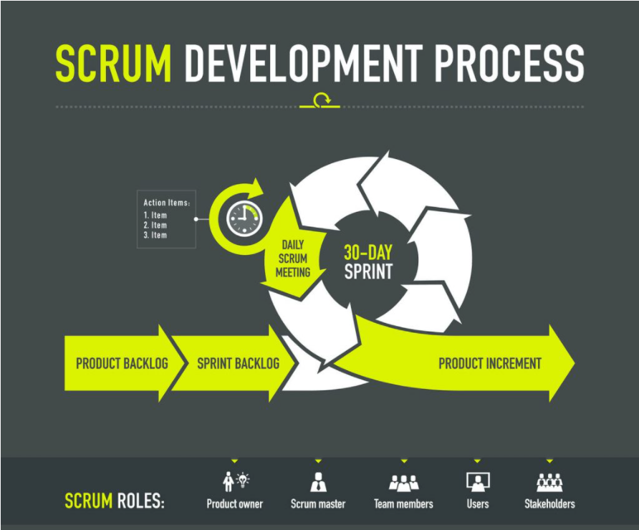
Scrum

Slide 18
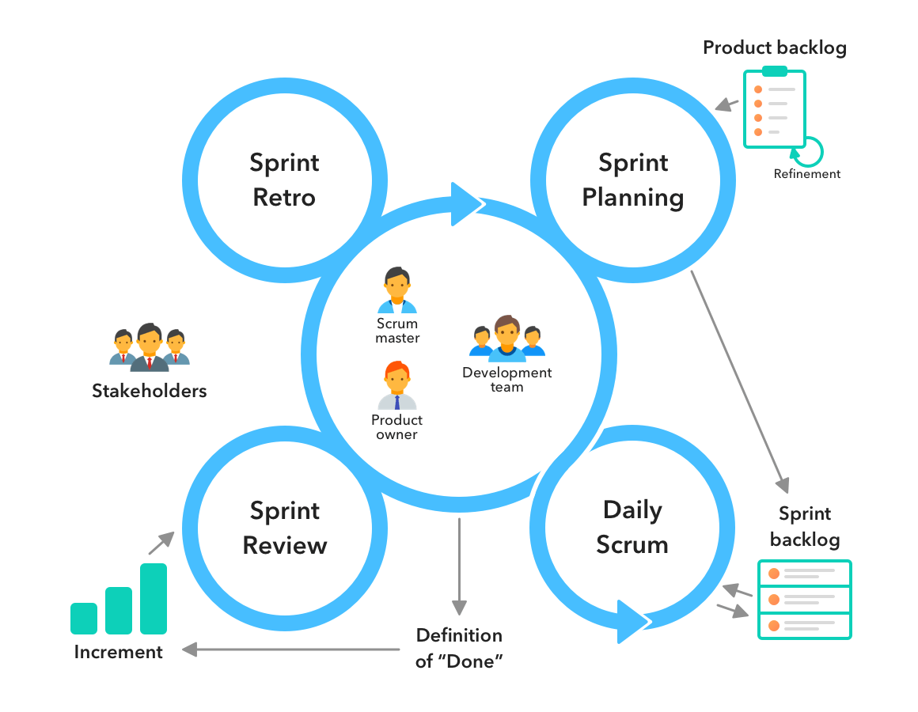
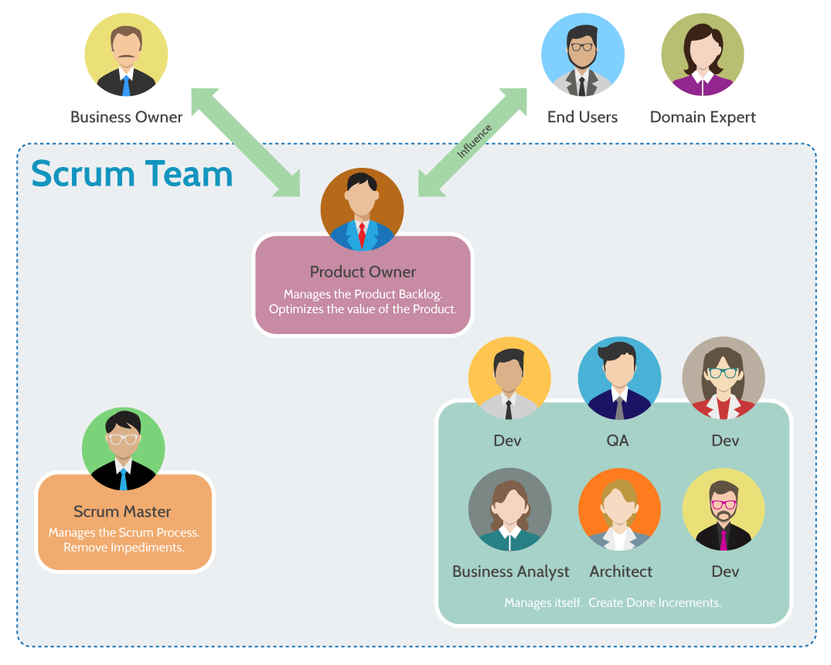
Scrum Elements, Roles and Management
A scrum team needs three specific roles: product owner, scrum master, and the development team. And because scrum teams are cross-functional, the development team includes testers, designers, UX specialists, and ops engineers in addition to developers.
Scrum project management is a methodology for managing software delivery that comes under the broader umbrella of agile project management. It provides a lightweight process framework that embraces iterative and incremental practices, helping organizations deliver working software more frequently.

Slide 19
6
Sample Image – Can be changed
Different Methodologies in Agile

Slide 20
5 Important Types Of Agile Methodology
Scrum
Extreme Programming (XP)
Crystal
Dynamic Systems Development Method (DSDM)
Kanban
The word Kanban is of Japanese origin and its meaning is linked to a time concept, “just-in-time”. In practice, the Kanban method exists in a board or table (Kanban board), divided into columns, that shows every flow of the software production. As the development evolves, the information contained in the table changes, and when a new task comes into play, a new “card” is created.
The Kanban method requires communication and transparency so that the members of a team can know exactly at what stage the development is and can see the status of the project at any time.
Scrum is, undoubtedly, the most used of the many frameworks of the Agile methodology. Scrum is characterised by cycles or stages of development, known as sprints, and by the maximisation of development time for a software product. It is usually used in the management of development projects for software products, but it can also be used in a business-related context.
Every day there are small 15-minute meetings, the daily scrum, that take the role of synchronising activities and finding the best way to plan the workday.
This is a typical Agile Development framework, developed by Kent Beck, and can be adapted to development companies of various dimensions. It is a methodology that emphasises values such as Communication, Simplicity, Feedback, Courage and Respect and prioritises customer satisfaction over everything else. This methodology offers trust to the developers by motivating them to accept changes in the customer’s requirements, even if they arrive in a later stage of the development cycle.
Teamwork is extremely important in XP, since when there is a problem, it is solved by the whole team of managers, developers or customers. They are all essential pieces of the same puzzle, hence creating a fertile environment for high productivity and efficiency in a team. In Extreme Programming, software is tested from day one, collecting feedback to improve development.
Crystal is a family of Agile methodologies that includes Crystal Clear, Crystal Yellow, Crystal Orange, Crystal Red, etc. Each has a unique framework. Your choice depends on several project factors, such as your team size, priorities, and project criticality.
To address the need for a standard industry charter for the swift delivery of software, the Dynamic Systems Development Method (DSDM) was developed. DSDM gives a comprehensive structure that is defined and modified to create a plan, execute, manage, and scale the procedure of software development. Based on a business-driven approach and eight principles, the DSDM believes that modifications to the project are always expected, and quality with timely delivery must never be negotiated.

Slide 21
7
Sample Image – Can be changed
Advantages and Disadvantages of Agile

Slide 22
Advantages of Agile Model
Customer satisfaction by rapid, continuous delivery of useful software.
People and interactions are emphasized rather than process and tools. Customers, developers and testers constantly interact with each other.
Trust between customers and developers is established and a positive culture is created in which everyone expects the project to succeed.
Working software is delivered frequently (weeks rather than months).
Face-to-face conversation is the best form of communication.
Close, daily co-operation between business people and developers.
Continuous attention to technical excellence and good design.
Regular adaptation to changing circumstances.
Even late changes in requirements are welcomed.

Slide 23
Disadvantages of Agile Model
In case of some software deliverables, especially the large ones, it is difficult to assess the effort required at the beginning of the software development life cycle.
There is lack of emphasis on necessary designing and documentation.
The project can easily get taken off track if the customer representative is not clear what final outcome that they want.
Only senior programmers are capable of taking the kind of decisions required during the development process. Hence it has no place for newbie programmers, unless combined with experienced resources.

Slide 24


